Slide 1

© RE Today 2021 © RE Today 2021

Slide 2




Activity 4:
Role Play
On tonight’s episode of ‘Case Studies’ chat show we will be talking about how religious people are caring for the environment, with special guests Rabbi Katy Allen and Dr Vandana Shiva.
Decide, in your groups who is going play each role:
Dr Vandana Shiva
Rabbi Katy Allen
Chat show host
BIG QUESTIONS BIG ANSWERS – Investigating worldviews Editor: Fiona Moss © RE Today 2021

Slide 3
Is there an extra question your group would like the host to ask?
Write your extra question on this question card:
The host’s question cards
The host will ask Dr Shiva and Rabbi Allen these four questions:
What do you do to help the environment?
2) Why do you think it is important to care for the environment?
3) Why do you think your work for the environment is so important?
4) What would you like to see other people doing to help the environment?
BIG QUESTIONS BIG ANSWERS – Investigating worldviews Editor: Fiona Moss © RE Today 2021

Slide 4
Now work together to think about what answers Dr. Shiva and Rabbi Allen would give.
Rehearse your role play.
BIG QUESTIONS BIG ANSWERS – Investigating worldviews Editor: Fiona Moss © RE Today 2021

Slide 5





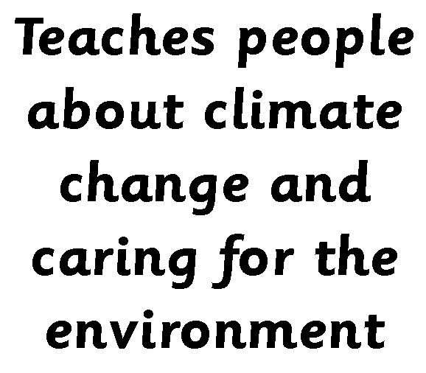




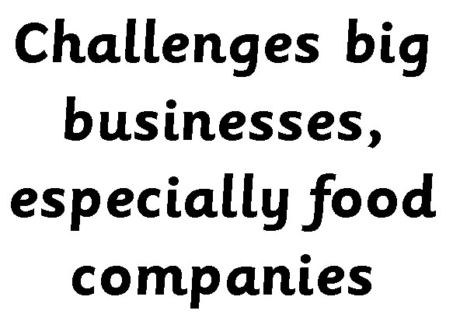
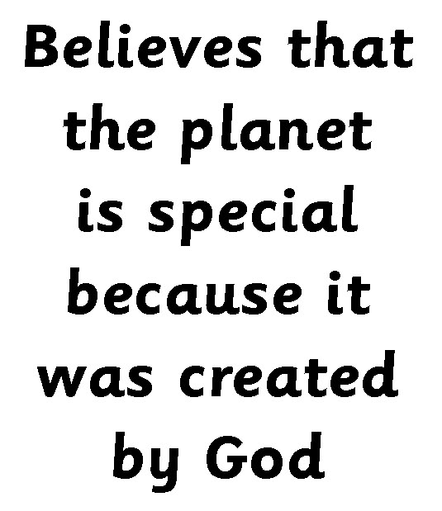
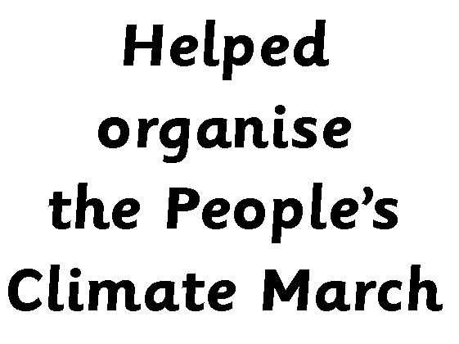
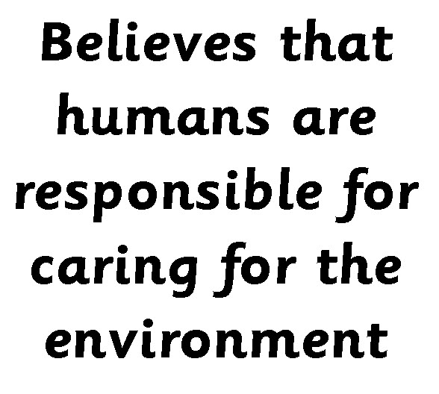
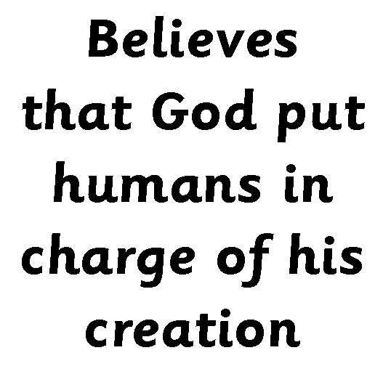

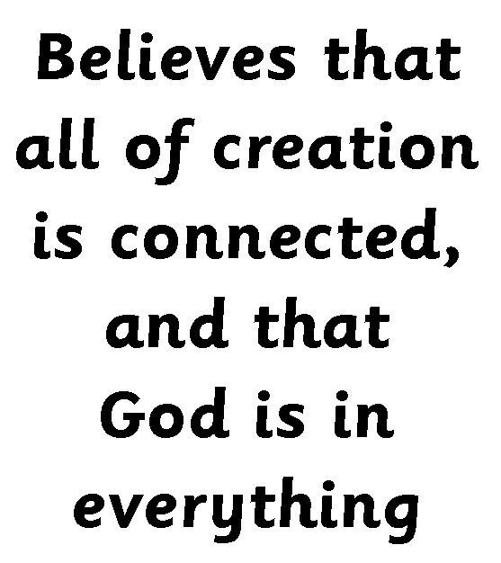

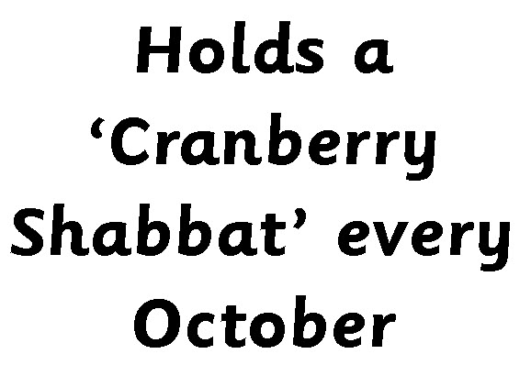
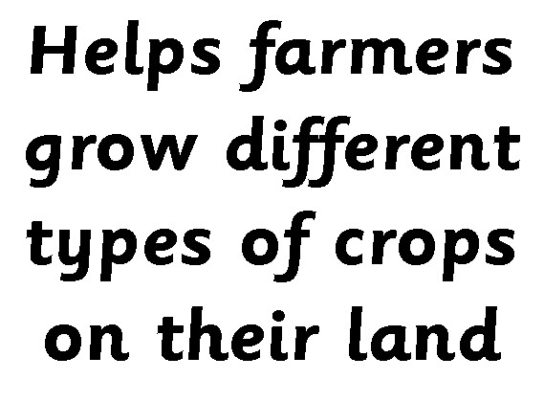
Activity 2
Resource 5.2
This resource is to be used with the case studies on page 23.
After reading the case studies about Dr Vandana Shiva and Rabbi Katy Allen, use the card sort to test pupils’ knowledge, arranging the statements into a two-circle Venn diagram (slide 3).
The statements are arranged with those applying to Rabbi Allen on the left, Dr Shiva on the right and those which apply to both of them in the middle.
BIG QUESTIONS BIG ANSWERS – Investigating worldviews Editor: Fiona Moss © RE Today 2021
Notes:
The statements on this slide (from the card sort list) can be copied and pasted.

Slide 6
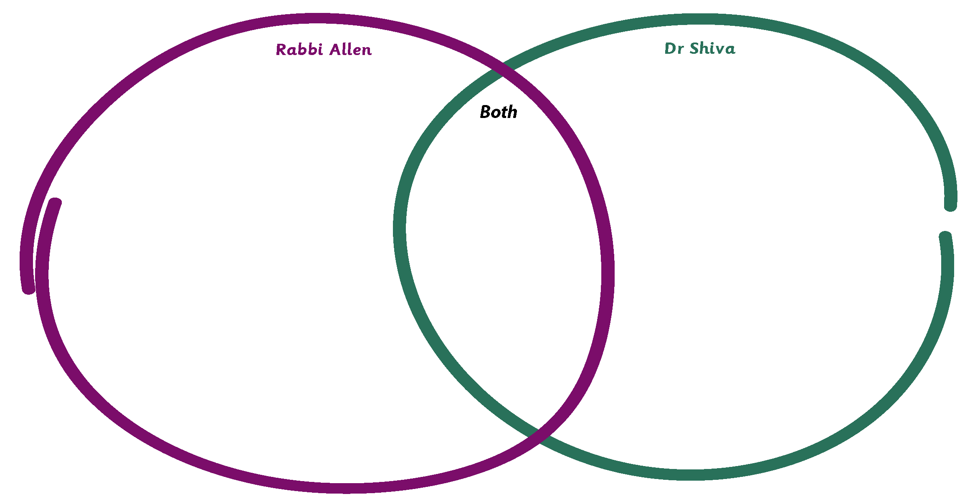
Resource 5.2
Venn Diagram
Comparing Rabbi Katy Allen and Dr Vandana Shiva
BIG QUESTIONS BIG ANSWERS – Investigating worldviews Editor: Fiona Moss © RE Today 2021

Slide 7
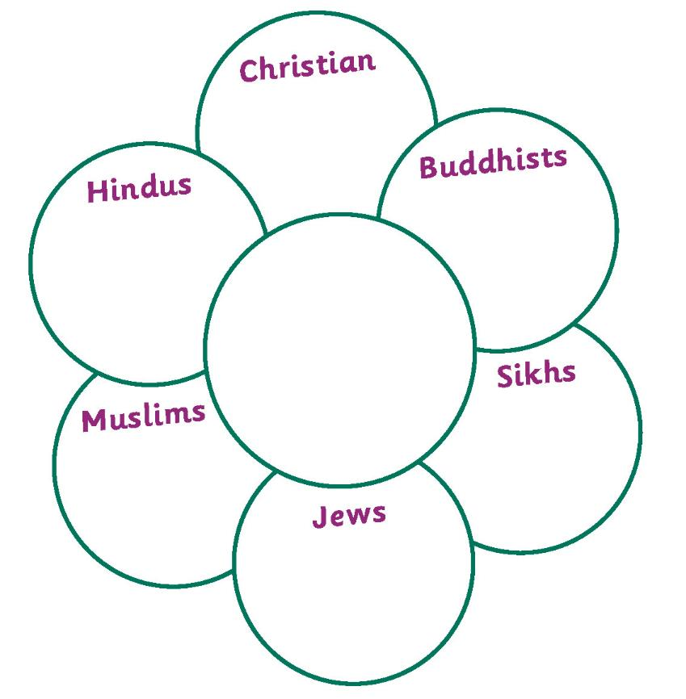
‘Belief Flower’
Resource 5.3
After we have read the summaries on p. 24 and talked about them, fill in the ‘belief flower’, to show what you have learnt.
Make your flower as detailed as you can.
Be creative and perhaps add some colour, too.
The centre of the flower is for the beliefs all of these religions share about the environment.
BIG QUESTIONS BIG ANSWERS – Investigating worldviews Editor: Fiona Moss © RE Today 2021

