Slide 1
The Autumn 2020 issue of RE Today magazine features Greta Thunberg, Pope Francis, Yusuf Islam / Cat Stevens, Jonathan Bartley, Ruth Valerio and 30+ ideas from teachers on our theme ‘Green Religions?’

Slide 2
Art in Heaven competition theme
God’s Good earth?
This year we are using this theme for Art in Heaven, running till 31st July. I would like to invite a huge entry from your school – all pupils?
As usual, 40 prizes of £25 each, a little more for 14-19s and whole class group entries.
The theme has wide resonances with environment and religion.
Here are some early pupil entries.

Slide 3
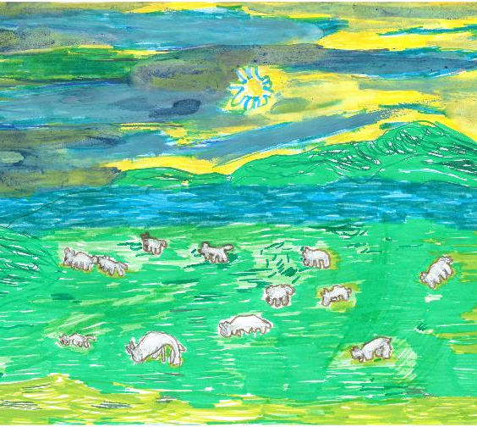
Louis (5)
Limpsfield C of E infant school
Beautiful lambs
This is my picture of beautiful lambs in Limpsfield.
I like them so much especially the little ones.
They are so soft when I think of God’s good earth I think of lambs.

Slide 4
6 year old: ‘What the Turtle Says’

Slide 5
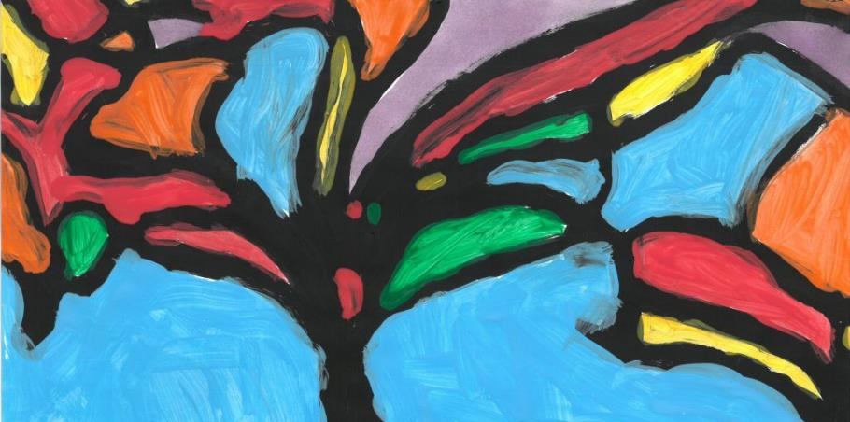
Lydia (6) Tree of Peace
“I chose this title because the colours look calm like peace – especially the purple. Doing this picture helped me think about my family and how everything in the world is connected. We are spoiling the earth a bit – we are even making the weather go wrong! I hope people will notice that trees bring peace and calm in the world. The blue reminds me of the sky. We all need to look after it”.

Slide 6
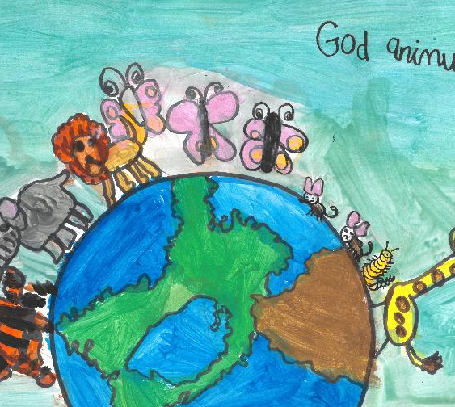
Mia (6)
Wembrook Primary School
He will give you a present
I love animals a lot, the world is the most important thing in my painting. God is a very nice person and he has no shows, his job is to keep everyone safe. We can’t see God but we know he is always there, he’s watching us. He is watching the people who are nice, then he will give you a present I think

Slide 7
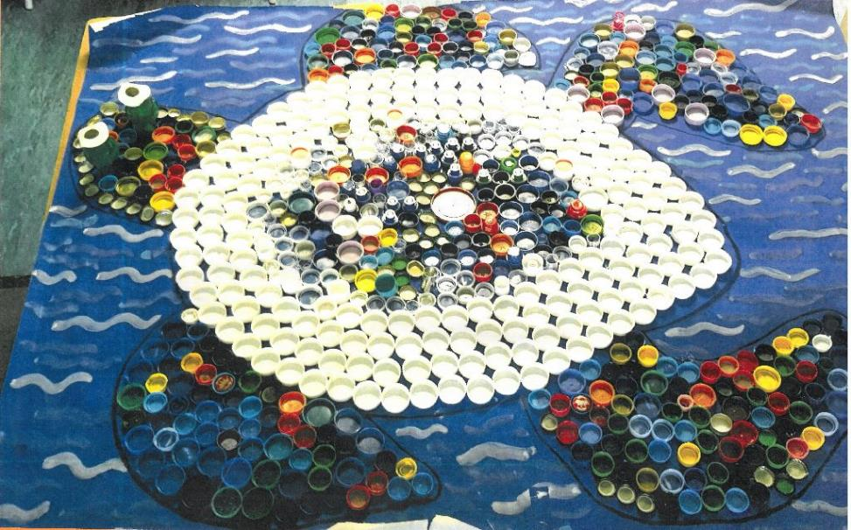
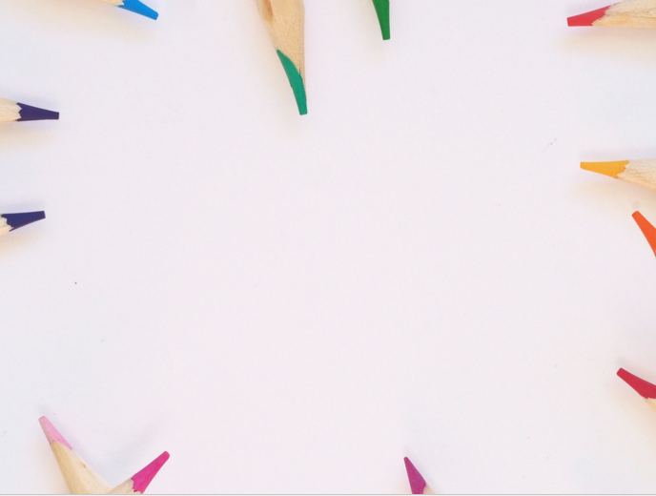

Charles, age 8 from St James Junior School, made his artwork with the help of his classmates.
I do not believe in any religion or any God…After oceans arose and the first life forms appeared like fish and the Turtle I (with the help of my class) have created. The humans evolved from the life forms in the ocean and started inventing materials such as plastic. These plastics are destroying sea life and we have showed that in our artwork, that the turtle is covered and made from plastic. All the creatures are slowly dying, and they have the same value as humans. I believe if there was a God, would he really let this happen?

Slide 8
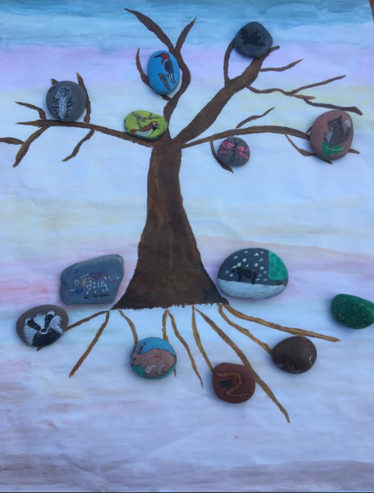
The Tree of Life Rosie is 8
"The tree can be seen as the centre of the earth where every animal and person rely upon the tree and look to it to give them shelter, food and oxygen. The tree needs people and animals to treat it respectfully and honourably so that it is able to do these things for many centuries to come, filling the world with life and laughter and making God’s earth a happy place.
If we do not respect our earth with the animals, insects, plants and trees on it the earth will never recover and slowly crumble away leaving only destruction behind.”

Slide 9
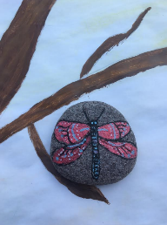
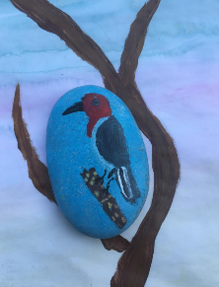
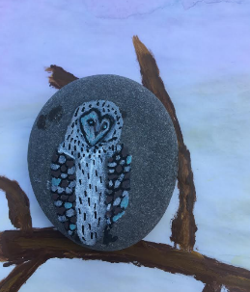
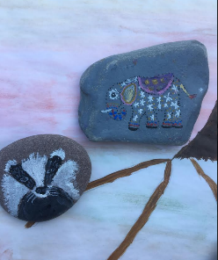
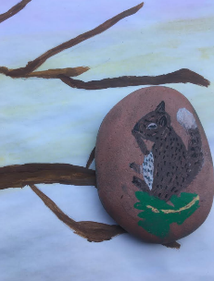
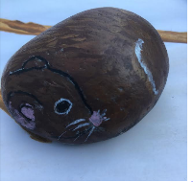
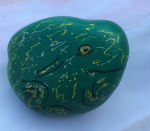
Rosie’s art close up!

Slide 10
Amy, 10.
Awful sea of plastic.
“The girl’s head is full of an overheated world – is this real, or just imagination? At the moment it might still be imagination, but in 10 years, it is real.
The sea, full of plastic and dead fish, is rising around her shoulders. We haven’t just ruined it all for the fish, but we will ruin the earth for ourselves to. We are literally drowning in our own stupidity. God help us!”

Slide 11
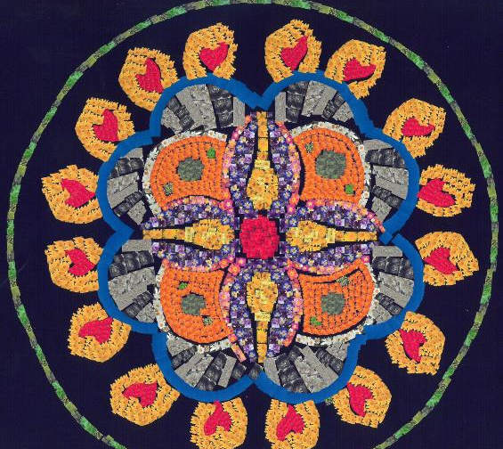
Emily (11)
Ivybridge Community College
Garden Photo Mosaic Mandala
I have chosen the category “Gods Good Earth” A mandala is a symbolic picture of the universe. At this time – during the Coronavirus lockdown – my universe has been reduced to my home and garden. I have chosen to decorate my mandala with hundreds of small images from my garden to represent what I have and can be grateful for.
The mandala is part of the Buddhist religion and represents an imaginary palace that is contemplated during meditation. Each part of the mandala represents an area of my garden and you can imagine yourself there, whilst taking some time to meditate.
During the creation of this art work, I have been able to recognise the colour and life that surrounds me. My garden has become my comfort blanket during these difficult times.
“The Earth is not just our environment. The earth is our mother” Dalai Lama

Slide 12
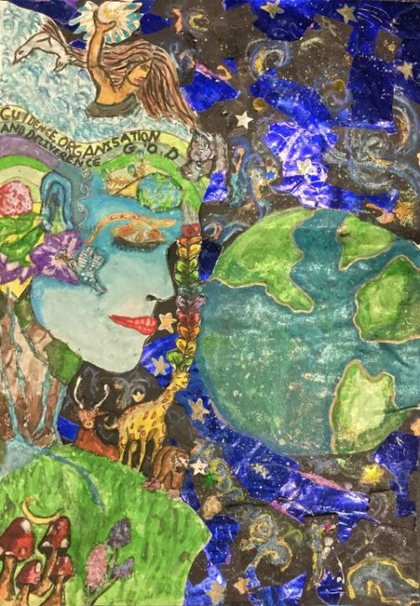

Isabelle, Charlotte and Astrid (all age 12) entered a group piece of artwork titled ‘Mother Earth’.
The religions that inspired our work were Hinduism and Paganism. Hinduism inspired us because of the Hindu belief that Brahman, the Hindu God, is in everything and is. But the original idea of Mother Earth came from the Pagan religion, based on the worshipping of nature and that God is like a mother because she has given us life and continues to sustain us.
This work is spiritual because it may remind people that the earth is a gift to us, we belong it and should look after it. This, therefore, is very relevant at the moment because humans are at a stage in their existence in which they really need to start caring and putting the earth and others before their own desires.

Slide 13
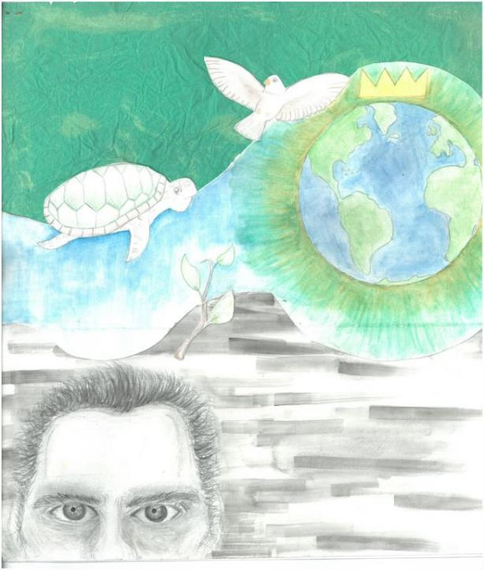

‘God’s Mystery’ by Amneek, age 14 from Stratford Girls Grammar School.
My painting is influenced by Job 12:7-10. The bottom half of the painting is in greyscale, to contrast with the bright colours above. This is to show that Job doesn’t see the full wonders of the universe – only God can see because he is omniscient, omnipotent and omnibenevolent. The man at the bottom is meant to be Job, and the river leads him to the Earth. I drew a plant, a dove and a turtle in reference to the old scripture: “But ask the animals, and they will teach you, or the birds in the sky, and they will tell you; or speak to the earth, and it will teach you, or let the fish in the sea inform you” (Job 12:7-8).

Slide 14
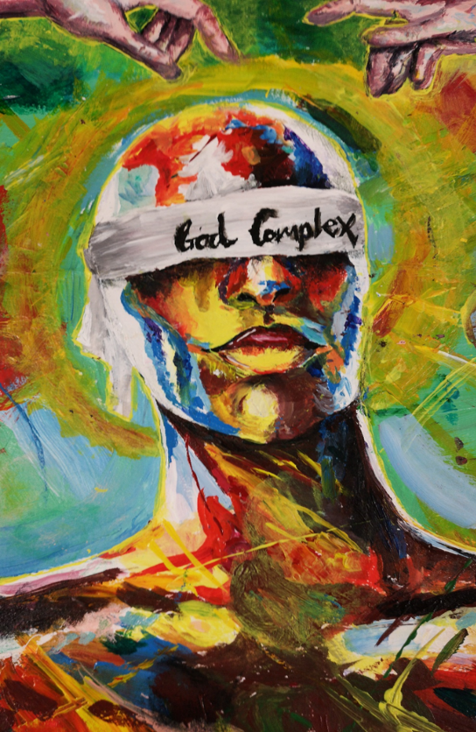
Humanity’s God Complex makes us think we can do anything. A delusion. www.natre.org.uk

Slide 15
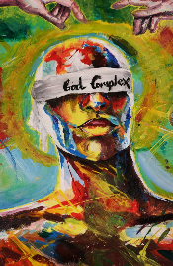
Humanity’s God complex. Artist is 15.
“A man wearing a blindfold which says ‘God Complex’ below two hands copied from the Michaelangelo painting of God creating Adam, God’s gift of life to humanity.
A ‘God-complex’ is a psychological disorder. Those afflicted believe themselves to be infallible, worth more than other people, blinded by their own arrogance and hubris – as the blindfold here shows. Such a ‘god complex’ means that a person may fail to acknowledge any evidence of a power higher than themselves. The blindfolded man refuses to acknowledge God, breaking the link between human and divine.
I wanted the unnatural and inhuman bright colours I used to paint the man to create a surreal and dehumanising effect: he believes himself to be, wants to be, more than human. While painting the hands of God and Adam, I used more naturalistic colour. I wanted to ‘humanise’ God. There is a disparity between these hands and the man, showing just how distorted man has become, far from the image of God. This distortion may ruin the earth.”

Slide 16
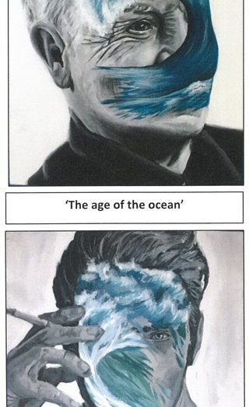
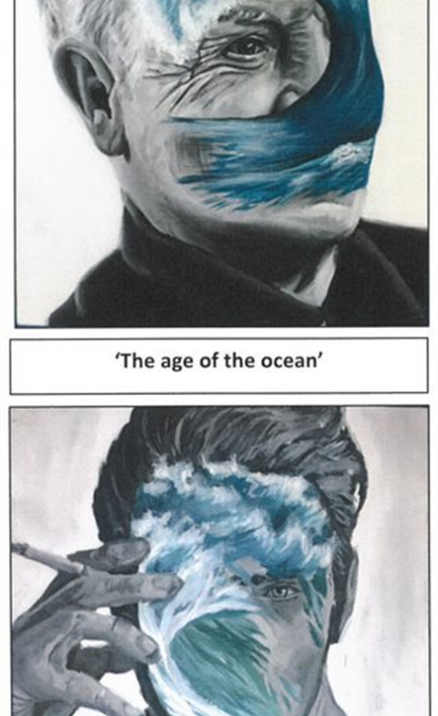

Slide 17
Adam is 17. A way to find God today? To care for the Earth
“God owns the earth, please take care of it” Deuteronomy 10:14
“With these two pieces of art I wanted to depict the human neglect of the global environment. Over the last century, people globally have disrespected God’s Good Earth, not appreciating the beauty and need for our shared home. As Pope Francis noted, “The earth, our home, is beginning to look more and more like an immense pile of filth.”
I created a metaphor within these two pieces, I left the waves in colour to shed light on our environment that has been disregarded and taken for granted. The people in the background are in black and white to exhibit the destruction and ignorance humanity has shown towards our earth, our climate.
The waves slowly fade away. Humanity takes over from nature slowly tearing away at nature. This will have a catastrophic impact on future generations: there will be extreme weather, flooding, forest fires, animals becoming extinct, destroyed habitats.
My intent was to create awareness. Our actions can be changed and we can retrieve our planet back to full health if we work collectively. If we as a human race take responsibility, we could take care of ‘God’s Good Earth’. That’s a way to find God today.”

Slide 18
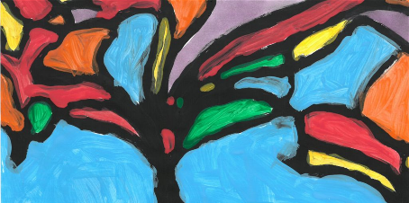
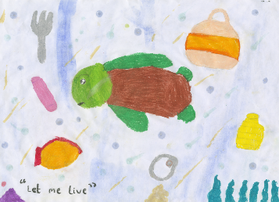
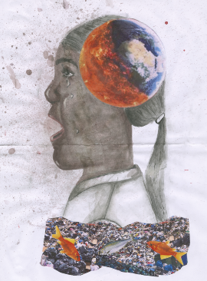

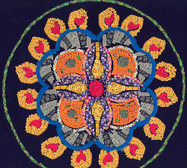
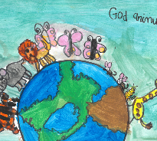

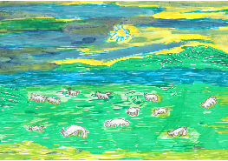
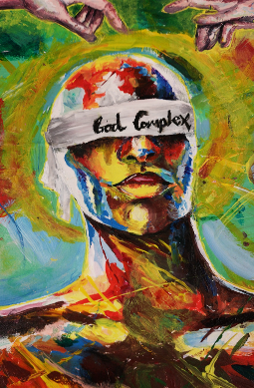
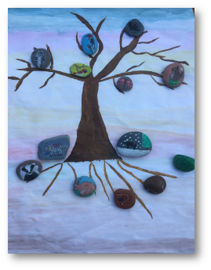

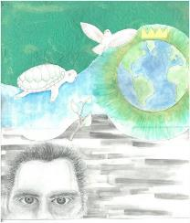
Student art on climate justice themes: treasured wisdom from young minds

