Slide 1
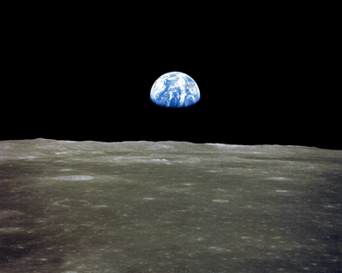
This is a kind of poem
The best way to read it is out loud – to someone else if you can. Discuss what you think it means, and then answer the questions on slide 6. If your answers are really thoughtful and imaginative, they may get published in RE Today magazine. We will send you a free copy.

Slide 2
If the earth was just a metre in diameter, floating a few feet above a field somewhere, people would come from everywhere to marvel at it.
People would walk round it, marvelling at its big pools of water, its little pools and the water flowing between the pools.

Slide 3
People would marvel at the bumps on it, and the holes in it, and at the very thin layer of gas surrounding it and the water suspended in the gas.
The people would marvel at all the creatures walking around the surface of the ball and at the creatures in the water.
The people would declare it as sacred because it was the only one, and they would protect it so that it would not be hurt.

Slide 4
The ball would be the greatest wonder known, and the people would come to pray to it, to be healed, to gain knowledge, to know beauty and to wonder how it could be.
People would love it, and defend it with their lives, because they would somehow know that their lives, their own goodness, could be nothing without it.
If only the world were only a few feet in diameter...

Slide 5
If the earth was just a metre in diameter, floating a few feet above a field somewhere, people would come from everywhere to marvel at it.
People would walk round it, marvelling at its big pools of water, its little pools and the water flowing between the pools.
People would marvel at the bumps on it, and the holes in it, and at the very thin layer of gas surrounding it and the water suspended in the gas.
The people would marvel at all the creatures walking around the surface of the ball and at the creatures in the water.
The people would declare it as sacred because it was the only one, and they would protect it so that it would not be hurt.
The ball would be the greatest wonder known, and the people would come to pray to it, to be healed, to gain knowledge, to know beauty and to wonder how it could be. People would love it, and defend it with their lives, because they would somehow know that their lives, their own goodness, could be nothing without it.
If the world were only a few feet in diameter.

Slide 6
Task 1: Questions. Write your answers neatly, but being thoughtful and imaginative is even more important.
What did you like about the poem?
What do you think the poem is really all about?
In the poem, if the earth was just a metre in diameter, it would be treated very well. But how do you think humans are treating the earth?
What do you think needs to change in the ways we treat the earth?
Who do you think needs to change their behaviour if we are to save the planet?

Slide 7
Task 2: Reflections
You can write either:
A poem (about the world and how it needs our care)
A prayer (to God, if you believe in God, about our fragile Earth)
A meditation (to humanity, perhaps, expressing what you believe about our planet).
Examples of pupils work follow on the next slides.

Slide 8
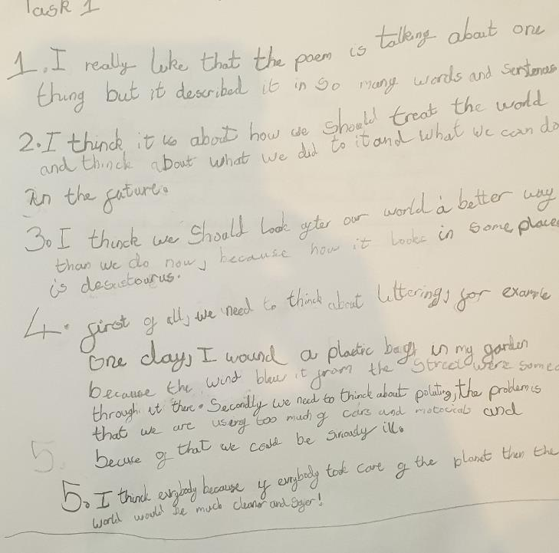
Lena, 8, writes about how humans can change to make the disaster of climate change less severe.

Slide 9
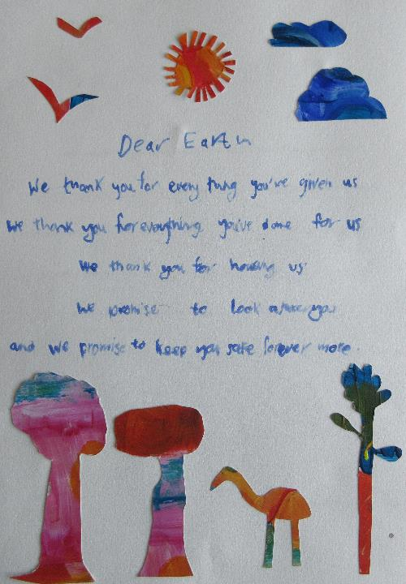
Stan is 8
He wrote a prayer to the Earth

Slide 10
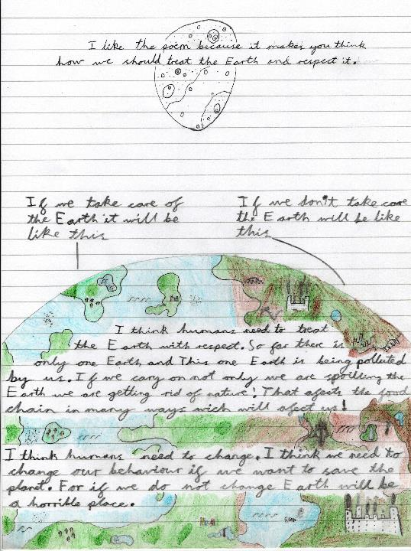
8 year old Sam gives his ideas about what it means to respect the earth and to change for the better. He liked the poem.

Slide 11
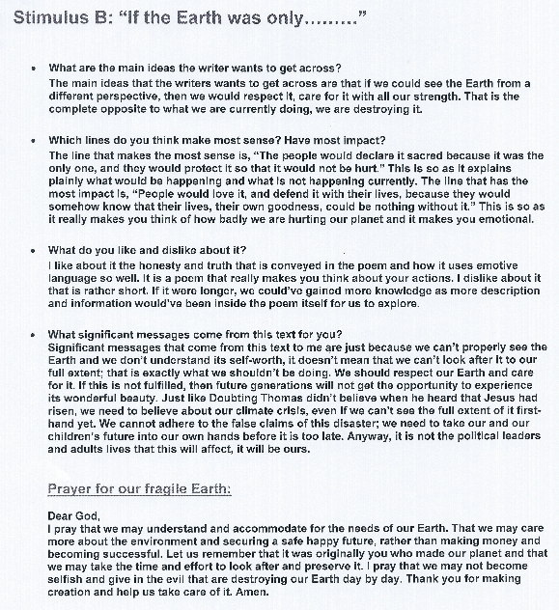
Amelia, 12, recognises the poem’s power and approaches its ideas with her thoughtful critical faculties engaged.
The connection to ‘doubting Thomas’ is well made and introduces a concept of faith in the future.
Her choice to write a prayer gives her the chance to express her own spiritual perspective.

Slide 12
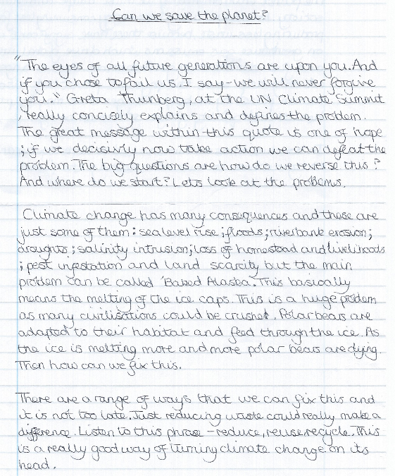
Hannah, 13, responds with her ideas about responding to the climate crisis, and references the video by Riding Lights ‘Baked Alaska’
See it here.
https://ridinglights.org/baked-alaska/baked-alaska-for-schools/

Slide 13
Use the work and learning ideas illustrated above with your pupils – the examples show that valuable thinking and responses from pupils aged 8-13 come from this work.
This PowerPoint supports the article on this topic from RE Today, page 48, Autumn 2020. Copyright
Image of Earthrise: wikicommons NASA - https://nssdc.gsfc.nasa.gov/imgcat/html/object_page/a11_h_44_6552.html

