Slide 1
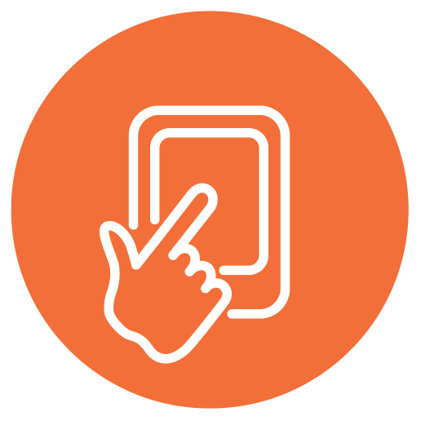
RE and Climate Justice
Visual learning connecting climate change and spirituality
This PowerPoint sequence supports ideas from Autumn 2020’s REtoday magazine article ‘The Big Picture’ which refer to the photomontage work of Nikolay Lamm and enable pupils to think for themselves about issues emerging from the rising sea levels
This downloadable resource, free to REtoday magazine subscribers and NATRE members, is © RE Today and may be used in your own school. Any other use is by written permission only.
© RE Today, 2017.

Slide 2
The Big Picture: Climate Central Miami
On the next slide you will see a ‘made up’ photo, by Nikolay Lamm. Get ready to write down four things you notice about the pic, and four questions it raises for you.
Current science predicts that human activity will warm the Earth by 2 degrees. Polar ice will melt, and sea levels everywhere will rise. How will life change?
Much more detail and examples of other cities can be seen on the Climate Central site: www.climatecentral.org/news/american-icons-threatened-by-sea-level-rise-in-pictures-19547

Slide 3
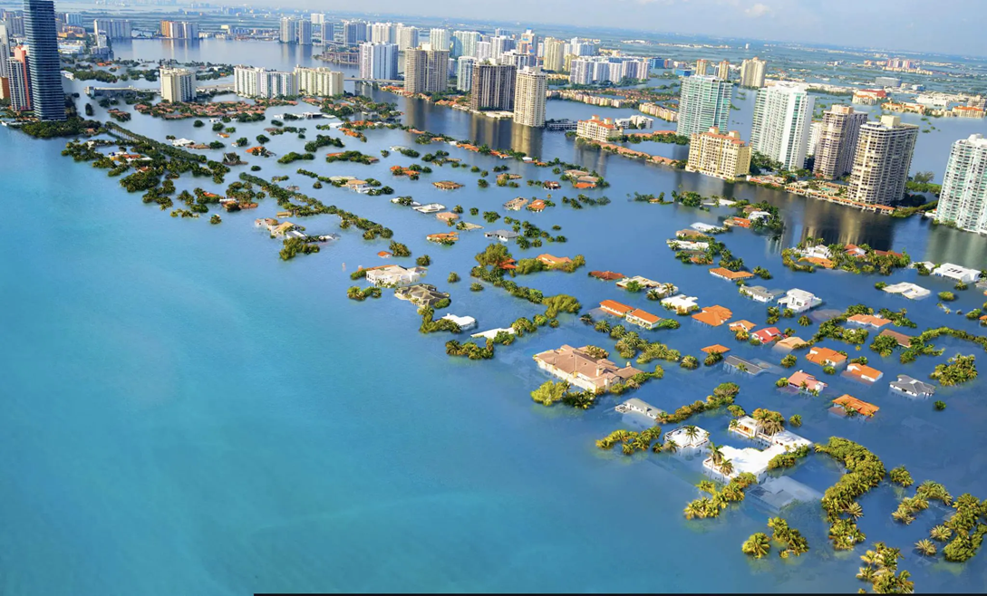
Four things you notice
Four questions the image raises for you
The
© RE Today, 2017.

Slide 4

What we noticed & what we would like to ask…
Noticed…
1.
2.
3.
4.
Want to ask…
1.
2.
3.
4.

Slide 5
Four facts connected to the picture:
The photo artist has imagined the city of Miami in Florida, one of the most low-lying cities in the USA, if the sea level rises as it will do under climate change predictions of a 2 degree rise in sea temperatures. This is imagination, but it is becoming reality.
Sea level is predicted to rise by nearly a metre in the next thirty years. Even ex-President Trump’s favourite golf resort at Mar-a-Lago will be underwater for nine months of each year if this happens.
‘King Tide’ surges in the Autumn cause flooding already, putting many roads underwater and surging seawater through the drains. Last autumn, one Miami resident found an octopus in his car park.
House prices in areas of low land are falling fast. People who bought a home near the beach a few years back fear they will be ‘in the sea’ soon. No one buys these houses anymore.
Americans pray much more than people in the UK. Imagine the prayer people in Miami pray.

Slide 6
Spiritual and religious ideas about climate change
“I’m Muslim. Allah says we are to be khalifah, guardians of His created world. We need to do a better job of guarding the future of the earth, in the name of Allah!”
“I’m a Christian. I think God wants us to change our ways to save the earth, which is a divine and precious creation.”
“Hindus like me believe that all life is one. We teach that Brahman is the universal life that animates everything. This means we must care for everything that lives and do no harm to the earth. In Hindu tradition, the goddess Bhumi IS the earth.”
As a non-religious person (but I am spiritual) I think that we should treat the whole earth as a living organism, and we should see ourselves as a part of that organism. We live together by changing our ways, or we die – and kill together as idiots. There’s no ‘Planet B’.
What would your spiritual sentence say?

Slide 7
© RE Today, 2017.

Slide 8
Two examples of ‘Miami Prayers’
“God, who made the Earth, You who love all of the world:
Forgive us for the foolish way we have lived, warming the globe, threatening life, endangering even ourselves
Guide us even now, late in the day, to change our ways and live for the salvation of your whole planet.
Amen”
“Spirit of love, change our hearts so that we come to love the beauty of the earth as you do.
Give us the vision to see a new world where all humanity lives for the justice of the whole planet.
In your mercy, God of the whole world, hear our prayer.
Amen.”
Which if the two do you like better? Why?
Write one of your own, or if you prefer a reflection…

Slide 9
After the flood, in the book of Genesis…
From Genesis 9: “God blessed Noah and his sons and said to them, “Be fertile, multiply, and fill the earth. All of the animals on the earth will fear you and dread you—all the birds in the skies, everything crawling on the ground, and all of the sea’s fish. They are in your power… As for you, be fertile and multiply. Populate the earth and multiply in it…
I am now setting up my covenant with you, with your descendants, and with every living being, the birds and all the animals of the earth… never again will all life be cut off by floodwaters. There will never again be a flood to destroy the earth.”
God said, “This is the symbol of the covenant that I am drawing up between me and you and every living thing with you, on behalf of every future generation. I have placed my rainbow in the clouds… God said to Noah, “This is the symbol of the promise that I have set up between me and all creatures on earth.” (Common English Version)

Slide 10
Imagine…
In conversation with your partner, consider what the implications of global sea levels rising are for London, or for your town or community.
The next slide shows you Nikolay Lamm’s projected picture of central London. We do have the Thames barrier, so maybe it would be different here…

Slide 11
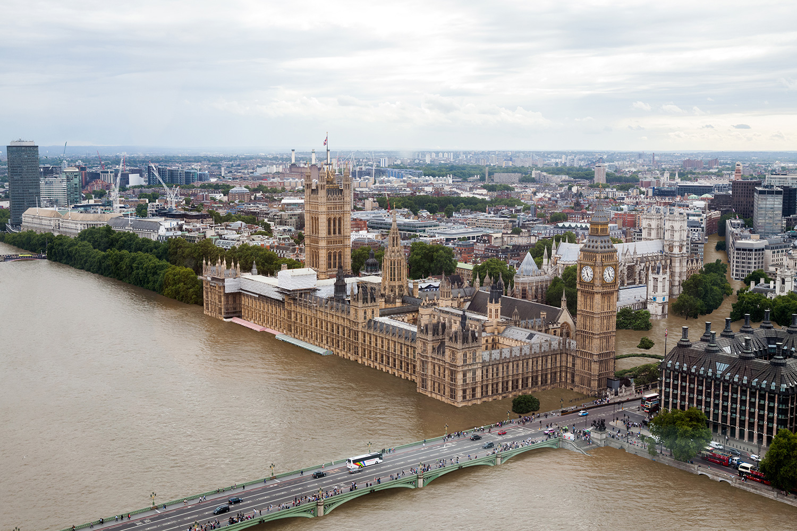
Consider the picture, then write your letter to your MP about tackling the climate crisis.
© RE Today, 2017.

Slide 12
Achievements – well done if you can say ‘yes’ to some of these
Can you:
Explain how and why Nikolay Lamm’s pictures of London and Miami are important in thinking about the ethics of climate change
Consider the similarities between the Bible story of Noah and our current climate crisis, giving your own view
Say why you prefer one prayer to another when thinking about rising sea levels
Write a reflection or prayer of your own, using ideas about climate change imaginatively
Write a campaigning message about climate justice to your MP, referring to spiritual or religious ideas of your own. Here’s the link: https://www.parliament.uk/get-involved/contact-an-mp-or-lord/contact-your-mp/
© RE Today, 2017.

Slide 13
RE and Climate Justice
Visual learning connecting climate change and spirituality
This PowerPoint sequence supports ideas from Autumn 2020’s REtoday magazine article ‘The Big Picture’ which refer to the photomontage work of Nikolay Lamm and enable pupils to think for themselves about issues emerging from the rising sea levels
This downloadable resource, free to REtoday magazine subscribers and NATRE members, is © RE Today and may be used in your own school. Any other use is by written permission only.
© RE Today, 2017.

