Slide 1

RE and Climate Justice: when Greta met the Pope
Great RE practice with a striking photograph
This PowerPoint sequence supports ideas from Autumn 2020’s REtoday magazine
This downloadable resource, free to REtoday magazine subscribers and NATRE members, is © RE Today and may be used in your own school. Any other use is by written permission only.

Slide 2
When Greta Thunberg met pope francis
Look carefully at the photo on the next slide and consider what it means. Which person is most powerful in this picture? Do they agree? What are they seeking to change?
© RE Today Services, 2020

Slide 3
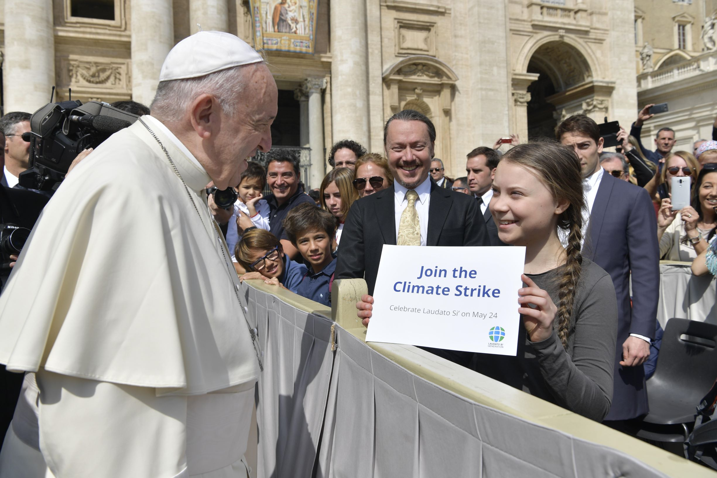
Greta Thunberg meets Pope Francis
Servizio Fotografico Vaticano
Copyright © · All Rights Reserved

Slide 4
Read the story of the picture on the next slide
Servizio Fotografico Vaticano
Copyright © · All Rights Reserved
© RE Today Services, 2020

Slide 5
In Pope Francis’ General Audience in St. Peter’s Square in April 2019 the Holy Father “thanked and encouraged Greta Thunberg in her commitment to defending the environment,”
The young Swedish activist, who asked to meet him, thanked the Pope for his commitment “in favour of the care of Creation.”
In fact, the Pope’s second encyclical, ‘Laudato Si’, a letter to all the world’s Catholics, is dedicated to the care of Creation and of our Common Home. The Pope says that in his letter “Laudato Si’ I have called the attention of humanity and of the Church on the most urgent questions related to the care of our common home and to the present and future of the peoples that inhabit it. The problems of the destruction of the natural environment are ever more grave, and the consequences on people’s lives are dramatic.”
Greta Thunberg, 16-year-old Swedish activist went to Rome to take part in a demo for the planet on Good Friday morning. The rally on climate justice in the Piazza del Popolo was organised with the young people of “Fridays for Future” Rome.
Greta wrote on her Twitter page @GretaThunberg: “On the way to the European Parliament, to the Italian Senate, to the Vatican and to Parliament during the Holy Week vacations, adding that on Friday “I will take part in the school strike in Rome. I know it is a legal holiday but as the climate crisis doesn’t take vacations, neither do we.”
© RE Today Services, 2020

Slide 6
The Assisi Declarations
Over 30 years ago, in 1986, to commemorate the 25th Anniversary of the World Wide Fund for Nature, religious leaders from 5 world faiths met in Assisi, the town made famous by Christianity’s green and animal-loving Saint Francis.
Each faith sent a leader to declare the religion’s views about nature and contributions to a greener future.
Read the next slide of 6 quotes Can you work out which comes from each religion (not easy)?
The slide after that has a writing frame and the photo on it. Please print the slide, and complete the writing frame. Of course if your work gets published, it will need to be neat and well written - but even more important it will need to be thoughtful, full of imagination and brilliantly expressed.
© RE Today Services, 2020

Slide 7
“May all beings live in safety with hearts full of joy Whether weak or strong, great or small, seen or unseen, far or near, born or to be born May all beings be full of Joy Let none deceive another, or despise any being whatsoever. Let none by anger or ill will wish harm to another.” | Love is patient, love is kind. It does not envy, it does not boast, it is not proud. It is not rude, it is not self-seeking, it is not easily angered, it keeps no record of wrongs. Love does not delight in evil but rejoices with the truth. It always protects, always trusts, always hopes, always perseveres. Love never fails. | “What is hateful to you, do not do to your fellow human”
“O Supreme Personality of Godhead, make me strong May all beings look on me with the eye of a friend May I look on all beings with the eye of a friend May we look on one another with the eye of a friend” | “O human beings! We created you from (a single pair of) a male and a female and have made you into nations and tribes that you may know one another. Indeed, the most honoured of you in the sight of God is the one who is the most deeply conscious of Him. Indeed, God is all-Knowing, all-Aware.” | “One who performs selfless service, without thought of reward, shall attain his Lord and Master. He himself grants His Grace; O Nanak, that the selfless servant lives the Guru’s teachings.”
© RE Today Services, 2020

Slide 8
“May all beings live in safety with hearts full of joy Whether weak or strong, great or small, seen or unseen, far or near, born or to be born May all beings be full of Joy Let none deceive another, or despise any being whatsoever. Let none by anger or ill will wish harm to another.” Buddhist, the Metta Sutra | Love is patient, love is kind. It does not envy, it does not boast, it is not proud. It is not rude, it is not self-seeking, it is not easily angered, it keeps no record of wrongs. Love does not delight in evil but rejoices with the truth. It always protects, always trusts, always hopes, always perseveres. Love never fails. Christian, 1 Corinthians, 13:4-8 | “What is hateful to you, do not do to your fellow human” Jewish, Talmud: Shabbat 31a.
“O Supreme Personality of Godhead, make me strong May all beings look on me with the eye of a friend May I look on all beings with the eye of a friend May we look on one another with the eye of a friend” Hindu, Yajur Veda, 36.18 | “O human beings! We created you from (a single pair of) a male and a female and have made you into nations and tribes that you may know one another. Indeed, the most honoured of you in the sight of God is the one who is the most deeply conscious of Him. Indeed, God is all-Knowing, all-Aware.” Muslim, The Qur’an, 49: 13 | “One who performs selfless service, without thought of reward, shall attain his Lord and Master. He himself grants His Grace; O Nanak, that the selfless servant lives the Guru’s teachings.” Sikh, Guru Granth Sahib, p.286
© RE Today Services, 2020

Slide 9
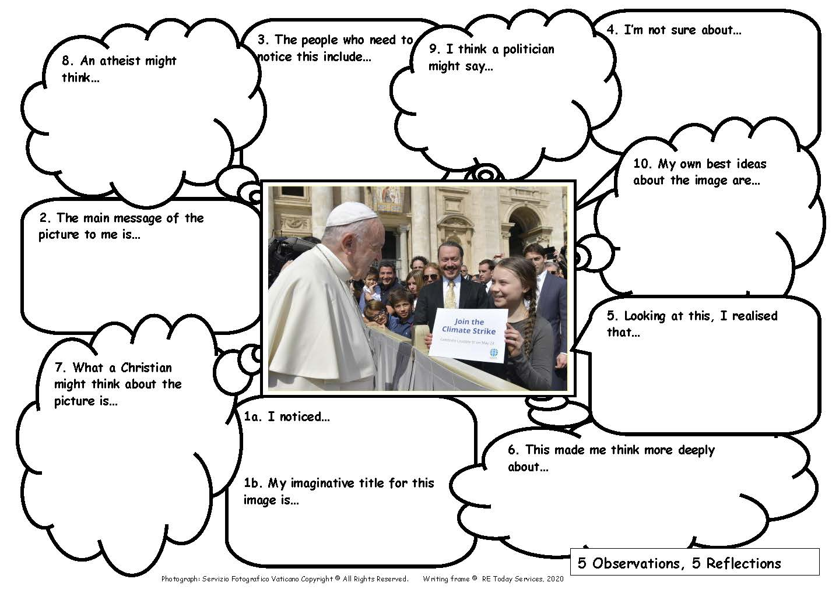
© RE Today Services, 2020

Slide 10
Examples of students reflections on the photograph
Here are examples from learners across the secondary age range
RE Today would like to thank the many students who worked on this activity for their insights and ideas, and their teachers for their support.
Read some of the examples before filling in the sheet for yourself.
© RE Today Services, 2020

Slide 11
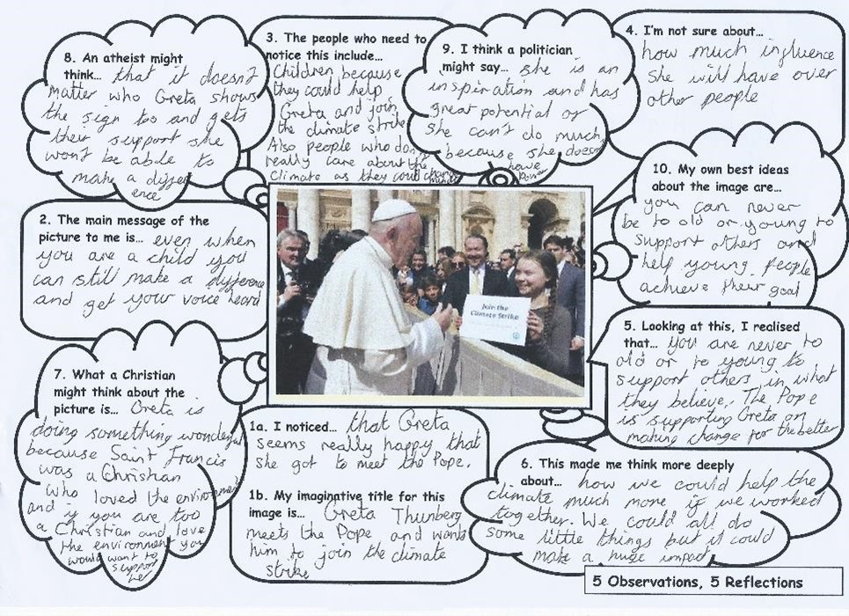
© RE Today Services, 2020

Slide 12
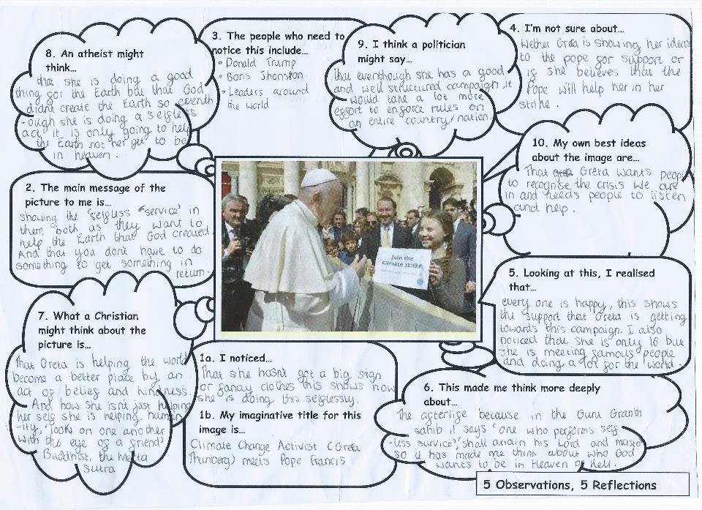
© RE Today Services, 2020

Slide 13
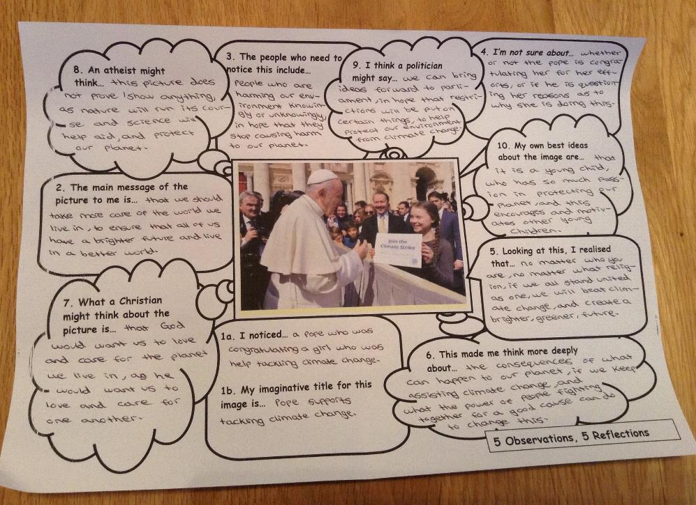
© RE Today Services, 2020

Slide 14
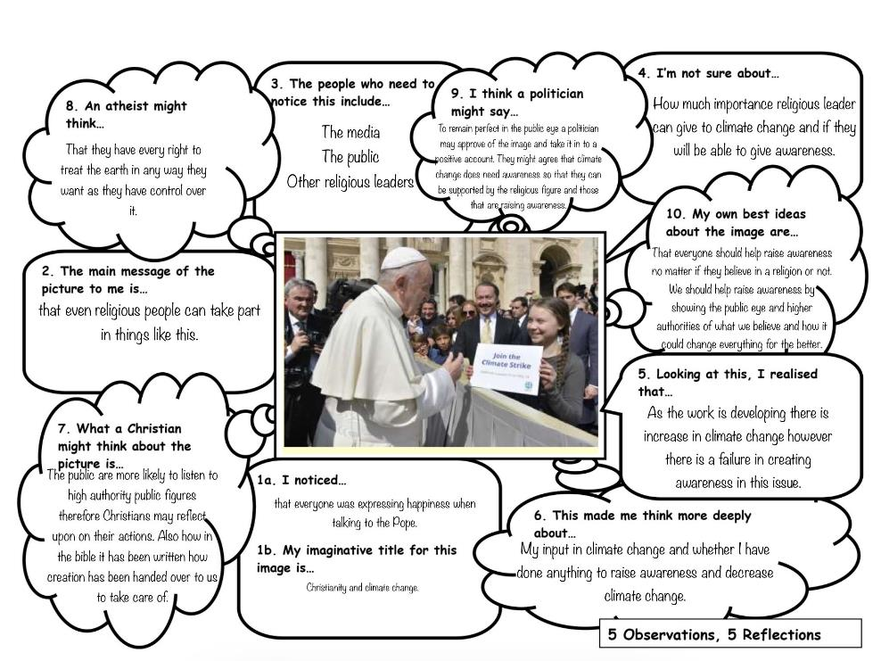
© RE Today Services, 2020

Slide 15
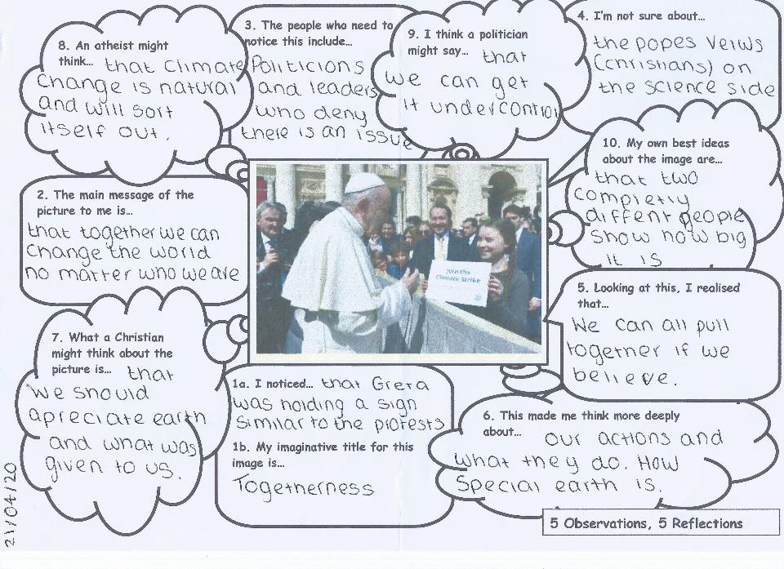
© RE Today Services, 2020

Slide 16
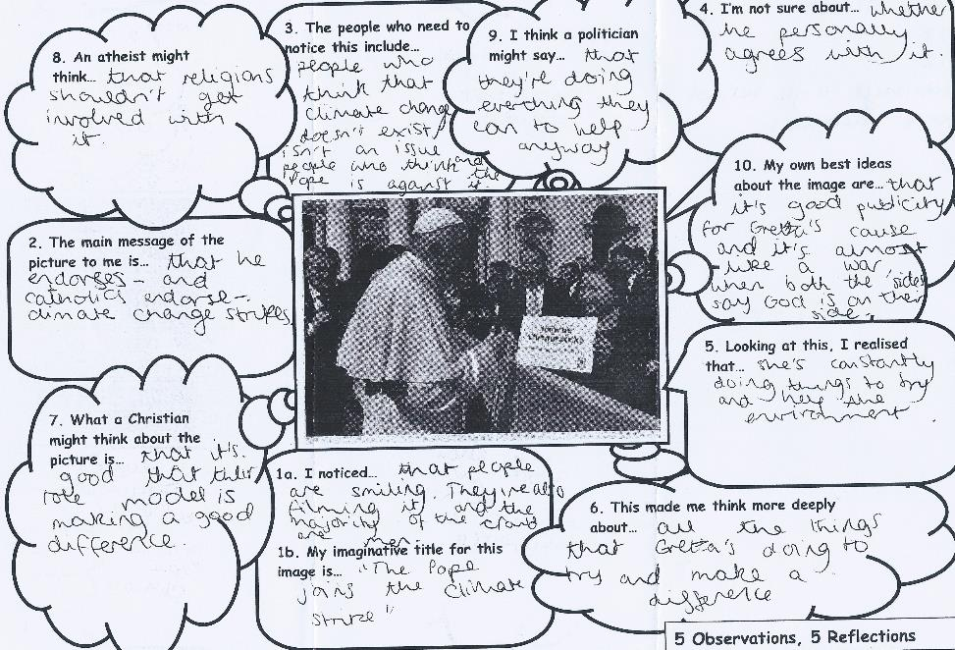
© RE Today Services, 2020

Slide 17
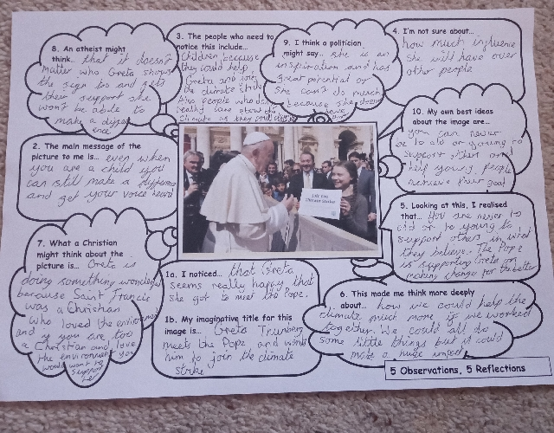
© RE Today Services, 2020

Slide 18
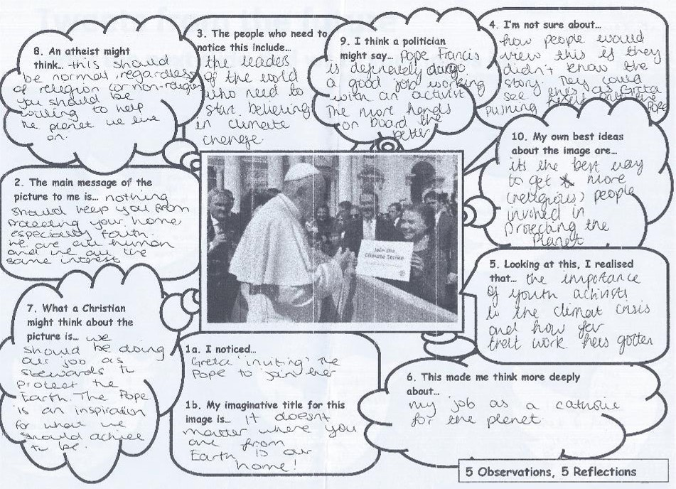
© RE Today Services, 2020

Slide 19
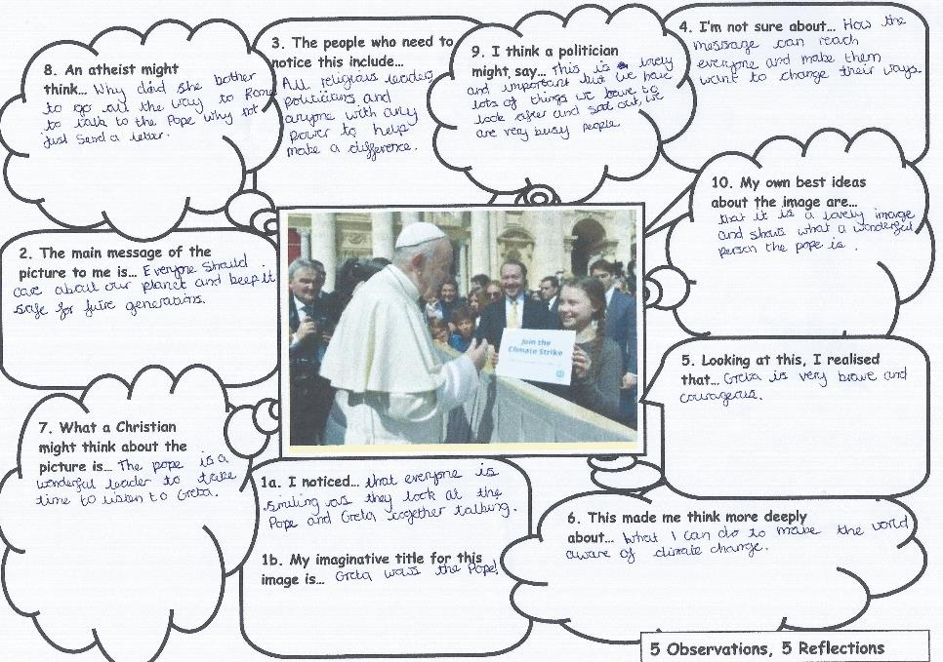
© RE Today Services, 2020

Slide 20
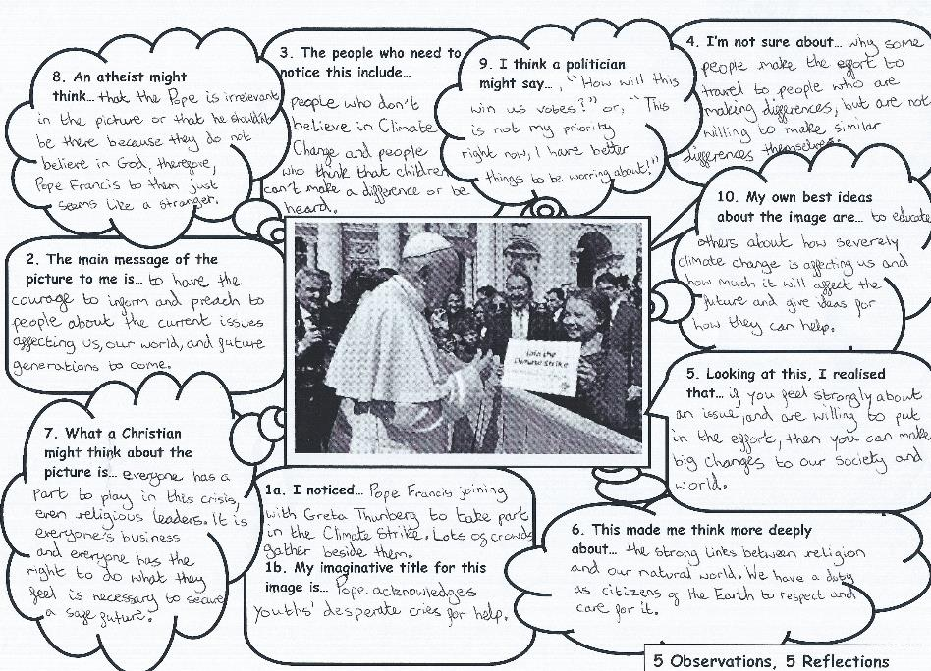
© RE Today Services, 2020

Slide 21
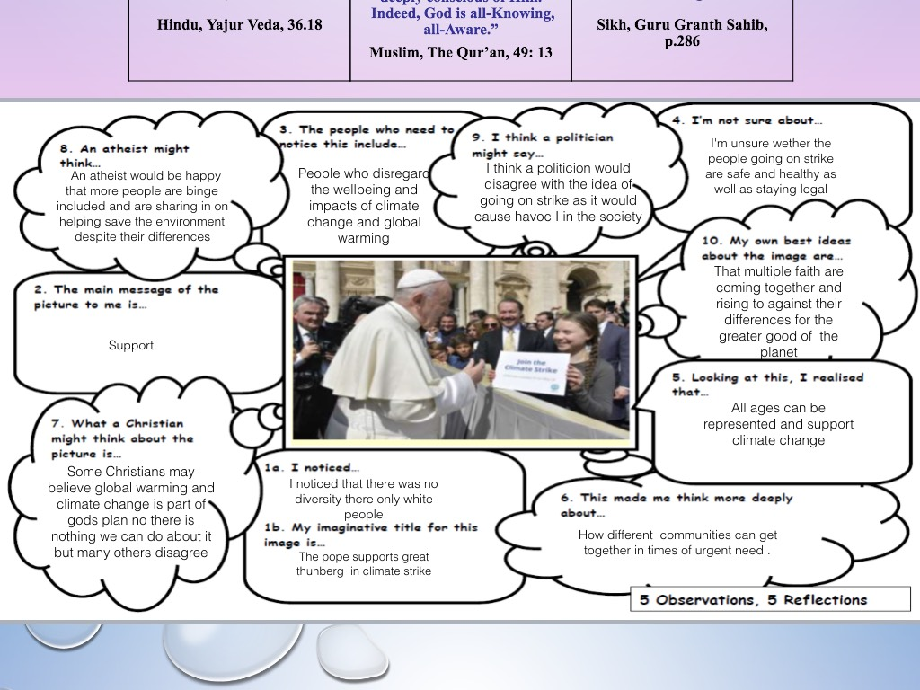
© RE Today Services, 2020

Slide 22
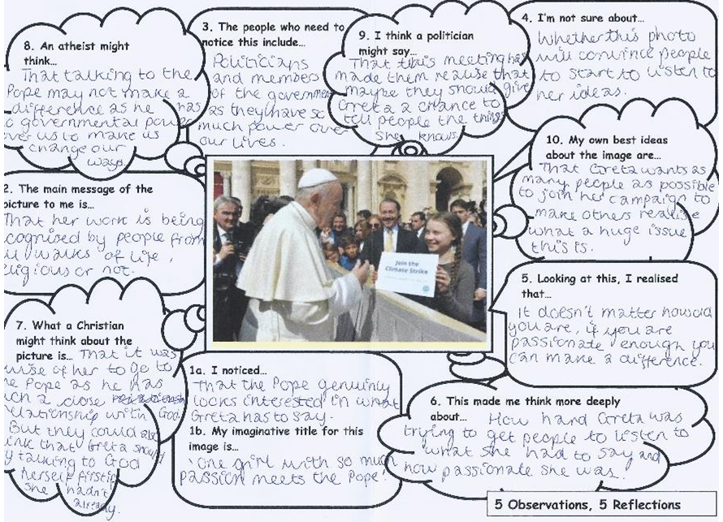
© RE Today Services, 2020

Slide 23
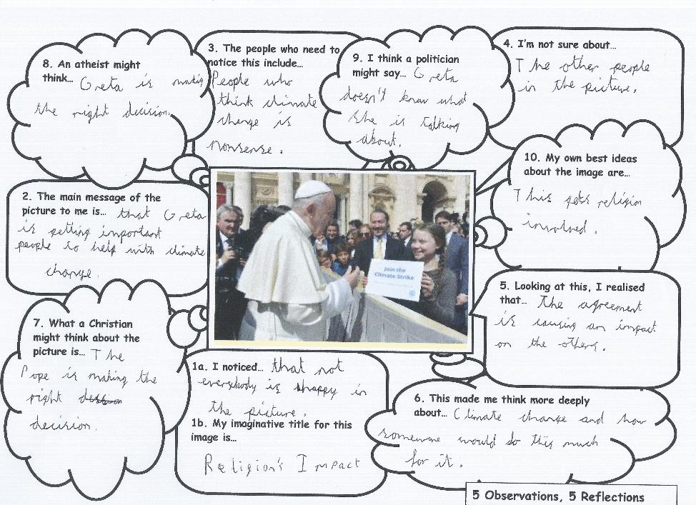
© RE Today Services, 2020

Slide 24
10 year old Isabella wrote her reflections on the photo of the meeting between two people who some call “prophets of our day”.
“I noticed that their differences didn’t matter. One was adult, one was not. One had power, one did not. What made these two people similar was that they both were united for the climate. Having different beliefs hinders no one. Different beliefs give us different motivations to keep going, different skills to use. Greta and Pope Francis were eager to do so, curious about the other’s opinion and determined to work together for our world.
What I see in the picture is how our beliefs give us motivation, which gives us the power to protect our planet. Without reasons for doing so, or admiration for the world, no-one would have the courage to try. People who think that collaborating with people of different religions hinders you need to notice this. Looking at this, I realised that the crisis won’t be solved by one person, nor by a group of people all thinking the same way. Only by collaborating with people of different beliefs will we succeed.
This made me think deeper about the effect fighting for the climate has on people’s lives and beliefs. Those that believe in a god may pray more often for the climate. They would draw hope to keep going from this.
Christians might think that because God created them equally, we should embrace our differences. Christians believe that God created the world - this may cause them to work together to save it. They’d get encouraged by their belief that He’s watching over them. Atheists may draw hope from facts showing hope for the future. Because atheists don’t pray to a god, they would be encouraged by other people with equal goals. They would be inspired by living people, rather than gods
My ideas about this image are that people seek ideas to solve our crisis in their religion or with other people. People look for reasons to keep going in different places - this isn’t a problem. We need diversity to solve this crisis, to gain different perspectives on the problem. The teamwork of Greta + Francis shows this perfectly. "
© RE Today Services, 2020

Slide 25
The thinking and writing frame can of course be used for many other stimulating photographs or texts with slight variations in the wording of the questions. The 6 texts from different scriptures above would be obviously good examples. When trying out the activity, we found this theme and this approach had very strong impacts on pupils across a wide – 7-16 – age range, and very powerful outcomes for both boys and girls. Many teachers who tried it agreed with RE teacher Fliss McPeake, who noted “I never manage to get as many boys opting for RS as girls but I don't think that's because they're not interested. More saving face against peers I think. But I sent this work out to 12-14s and was surprised at the boys who responded. They are interested in the ethics of climate change!!
Thanks to all the teachers and students who contributed to this activity and the fine work they sent in to RE Today
© RE Today Services, 2024

Slide 26
RE and Climate Justice: when Greta met the Pope
Great RE practice with a striking photograph
This PowerPoint sequence supports ideas from Autumn 2020’s REtoday magazine
This downloadable resource, free to REtoday magazine subscribers and NATRE members, is © RE Today and may be used in your own school. Any other use is by written permission only.

