Slide 1
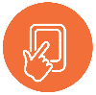
RE Today
Ready-to-learn idea for the classroom
An intriguing idea to enable pupils to think about climate justice
Tweets from the future
This PowerPoint sequence supports ideas from Autumn 2020’s REtoday magazine
This downloadable resource, free to REtoday magazine subscribers and NATRE members, is © RE Today and may be used in your own school. Any other use is by written permission only.
© RE Today, 2017.

Slide 2
Five tweets from the future
This simple idea asks pupils to imagine themselves into the future.
What messages would the future humans send to us?
Pupils create the messages, and share their ideas, developing a programme of climate justice action from their thinking
Present this to the class in imaginative, but not scary terms, making sure you emphasise – especially to younger pupils – that this is a kind of imaginary worst case, and if we listen and act, this can be stopped.
We know it is called ‘X’ now. We don’t care.
© RE Today, 2020.

Slide 3
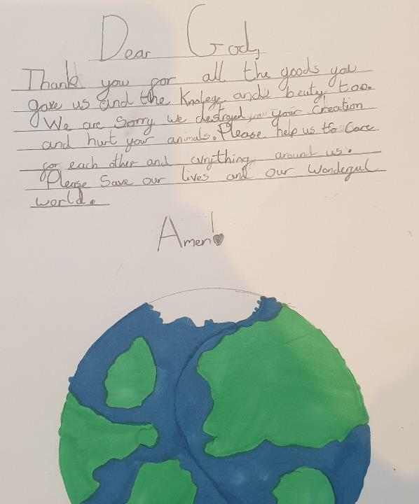
Invite your pupils to write the prayer a spiritual or religious person might say to God, asking for help, repenting or making promises.
Lena, aged 8 wrote this one.

Slide 4

Five tweets from the future
What messages from the future would we need to hear to jolt us out of our apathy? What could change our ways and secure a fairer and more sustainable future?
Thake five of these Twitter logos to write into.
Imagine that the predictions of the climate scientists from current human behaviour come true by the 22nd century, 100 years from now.
Things have got a bit apocalyptic! Disaster has come. Sea level has risen.
Peterborough and Manchester are now seaside towns.
Global famine has halved the world’s population: over 3 billion have died.
Food security is a thing of the past: only the most powerful are sure to eat each day. Everyone else is a forager.
Crises have ended air travel, the internet, burning fossil fuels – no more cars or driving. Horse-drawn is the new Ferrari. Tribal wars and conflicts about basic food and clean water are common.
From this ravaged future, what messages would the people send to us? How would they warn us?

Slide 5


Tweets from the future; prayers, warnings, wishes
Ask pupils to think about the messages our descendants will send us from 50 or 100 years ahead. What would they say to use about what we can do for God’s good earth?
Listen, 2020, you are killing us…
Please change one thing right now…
Many religions teach that Earth is holy, a gift to use, not for abusing but for us to love and care for. Can we repair the damage done?
I am your grandson. I beg you…
For God’s sake, and humanity’s sake…
What will your tweets say?

Slide 6
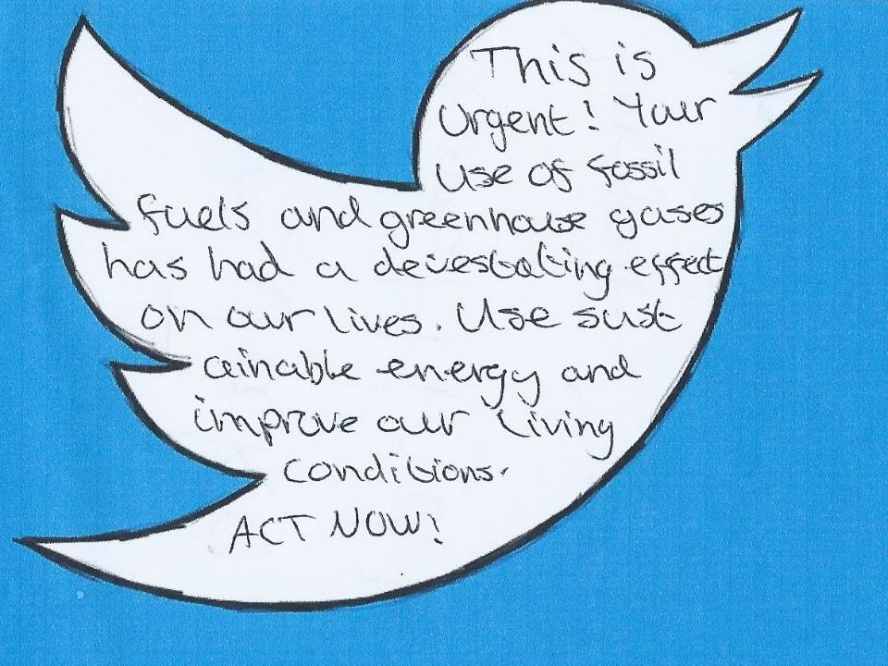

Slide 7
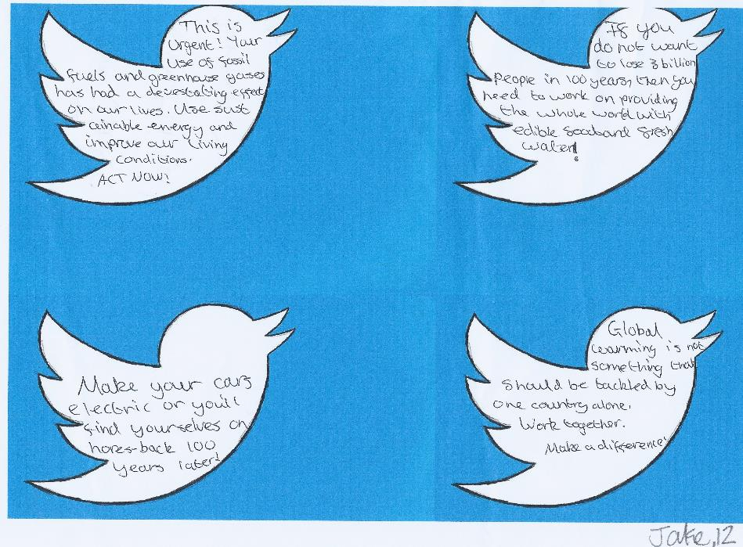
Now get ready to write some ‘tweets from the future’ of your own.
Do you want to include prayer or quotes from scriptures? Keep them short, but make them punchy, and strong! Can you do 4 or 5 different messages? Can you plan to share them in schools assembly?

Slide 8
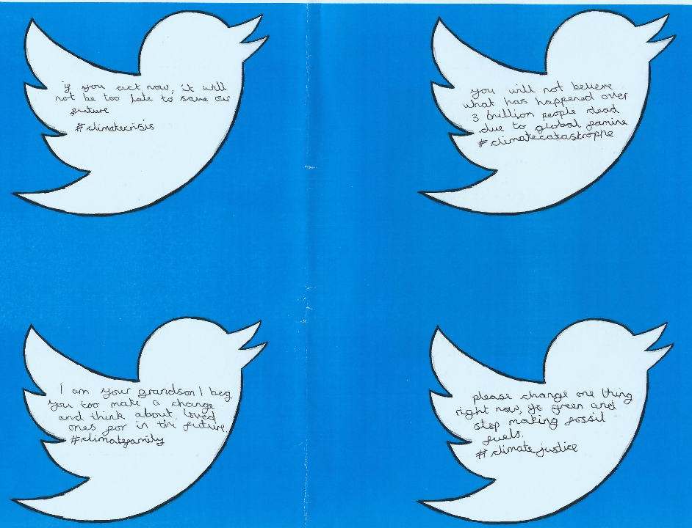

Slide 9
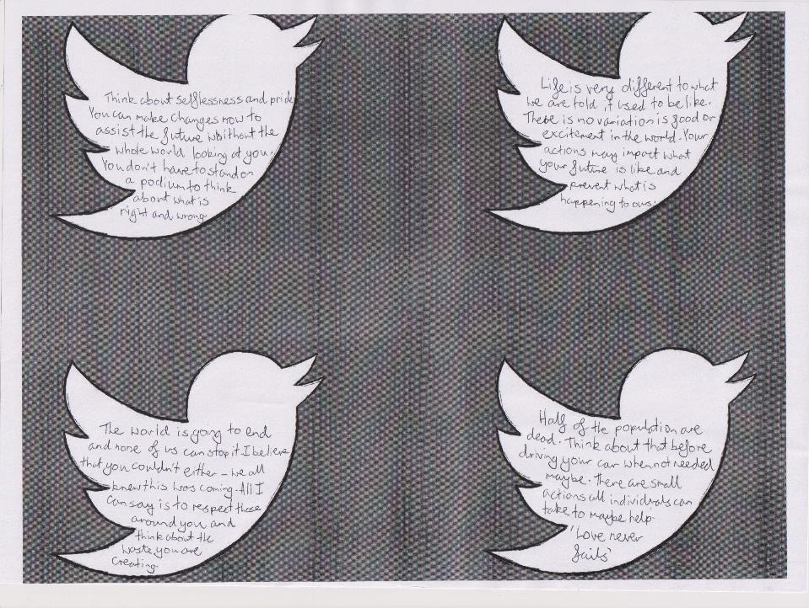

Slide 11
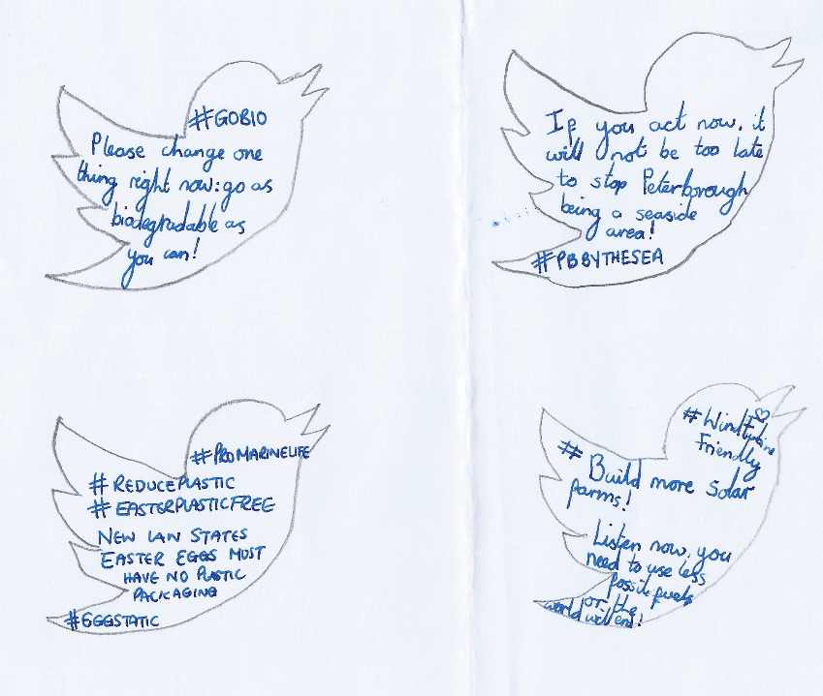

Slide 12
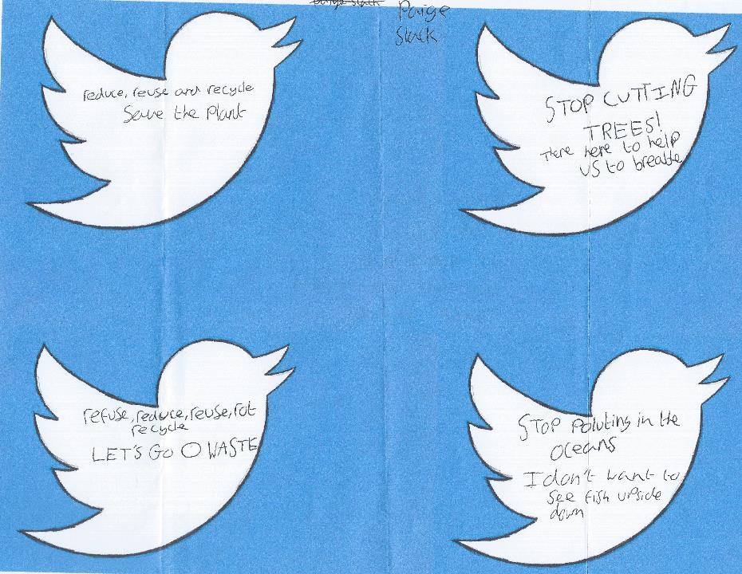
Now get ready to write some ‘tweets from the future’ of your own. Keep them short, but make them punchy, and strong! Can you do 4 or 5 different messages?

Slide 13


The amazing Riding Lights Theatre Company provided 7 short films for GCSE and RMPS examination students with support from Christian Aid. These are all free, with substantial support materials, including a film about what the future would say to us, and deliver to the GCSE objectives in many areas.
Access these wonderful resources here:
https://ridinglights.org/baked-alaska/baked-alaska-for-schools/

Slide 14
Ready-to-learn idea for the classroom
An intriguing idea to enable pupils to think about climate justice
Tweets from the future
Great thanks to all the pupils and teachers who took the time and trouble to try out this idea and all their wonderful work.
This PowerPoint sequence supports ideas from Autumn 2020’s REtoday magazine
This downloadable resource, free to REtoday magazine subscribers and NATRE members, is © RE Today and may be used in your own school. Any other use is by written permission only.
© RE Today, 2017.

