Slide 1


Interfaith Week Nov 8th-15th
2026
"Lighting the Way for a Shared Future"

Slide 2

A coalition of national interfaith organizations, including United Religions Initiative UK, the All Faiths Network, the Council of Christians and Jews, the Faith and Belief Forum, NASACRE, and Religions for Peace, took over responsibility for Inter Faith Week 2024 after the Inter Faith Network for the UK closed. As a focal point for interfaith activities that unite our communities split by events overseas and domestic conflicts, this group will work together to ensure that the yearly Week continues into the future.
Source: https://www.interfaithweek.org/

Slide 3

Inter Faith Week 2026 is set to take place from Sunday, 8th November to Sunday, 15th November, providing a national focal point for strengthening interfaith relations and increasing awareness of the diverse faith communities across the UK. Following the success of previous years, the week aims to showcase the vital contribution of religious and non-religious groups to their local neighbourhoods while encouraging people to engage in interfaith activity for the first time.
The 2026 program is expected to build on recent innovations, such as the "Community: Together We Serve" theme and expanded youth leadership initiatives, to further "burst the bubble" and reach audiences beyond traditional interfaith networks. By fostering dialogue, social action, and education in schools, workplaces, and community hubs, Inter Faith Week remains a key piece of civic infrastructure dedicated to building a more inclusive and respectful society.
The 2026 theme "Lighting the Way for a Shared Future” is a celebration of hope. Inspired by the symbolism of light across faiths and traditions, including the spirit of Diwali, the theme reflects a shared belief that even in challenging times, communities can come together to build understanding, trust and friendships.
Source: https://www.interfaithweek.org/

Slide 4

Interfaith Week for Schools (IFW4Schools) is a dedicated initiative - primarily led by the Faith & Belief Forum with partners - designed to help educators celebrate diversity, explore different faiths and beliefs, and build social cohesion. It provides a hub of free, high-quality resources, training, and event ideas.
Source: https://www.interfaithweek.org/

Slide 5

For 2026 Resources- use this link
Source: https://www.interfaithweek.org/

Slide 6
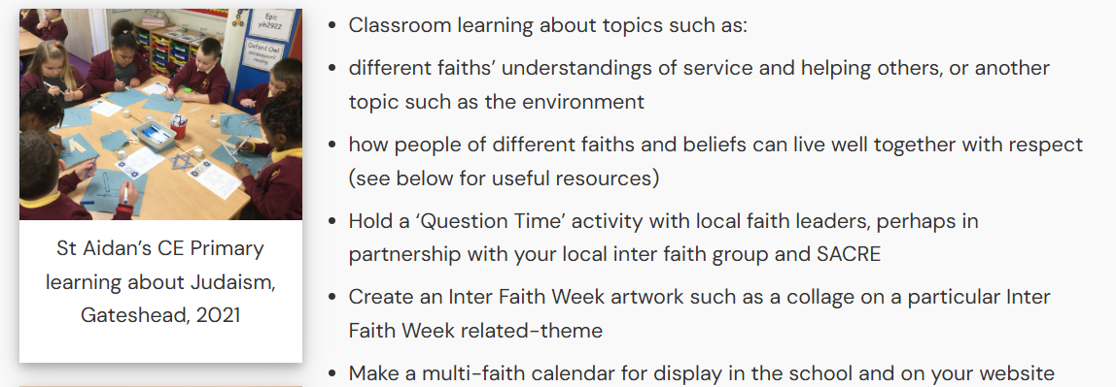
Source: https://www.interfaithweek.org/

Slide 7
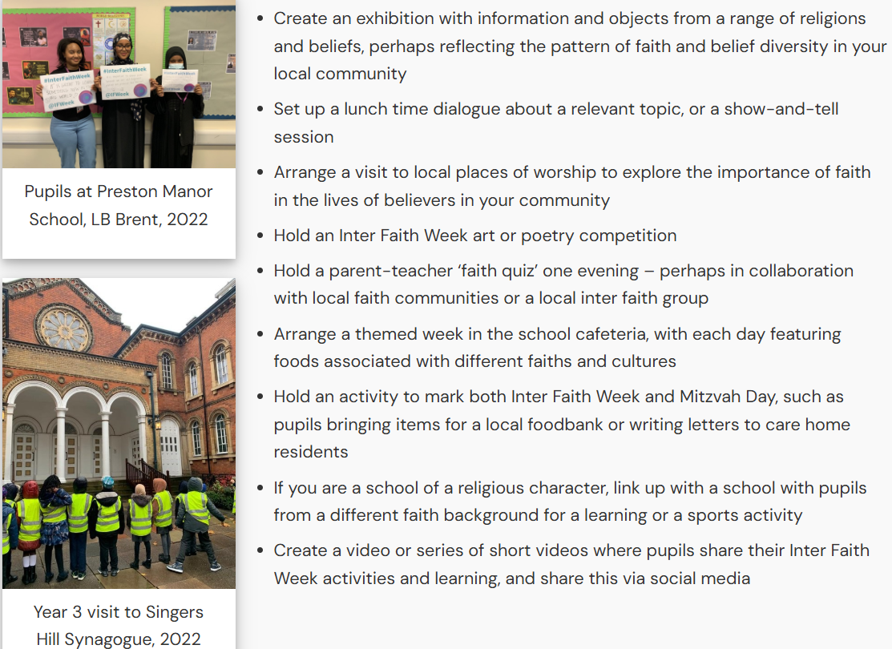
Source: https://www.interfaithweek.org/

Slide 8

Although the Inter Faith Network for the UK, which previously led Inter Faith Week, has now closed, a range of useful historical resources are still available. On this link, you will find a collection of resources for primary and secondary school teachers, including a series of videos that can be used for assemblies or collective worship. The IFN's publication, Connect: a youth inter faith action guide also contains relevant information, especially for students at Key Stage 4 and 5.
Further support might also be available locally through your RE Adviser, Lead/ASTRE teachers, or local SACRE. These resources can be used to organise activities during Inter Faith Week or throughout the year to help your school promote positive interfaith relations within your community.
The IFN's publication, Connect: a youth inter faith action guide also contains relevant information, especially for students at Key Stage 4 and 5.
Source: https://www.interfaithweek.org/

Slide 9

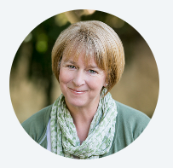
Click on the banner above to read Anne’s great blog that encourages schools to use storytelling and respectful dialogue during Interfaith Week to help pupils explore different faith perspectives, build understanding, and celebrate diversity in a safe and inclusive environment.
About
Anne Moseley began her teaching career in 1986, working with primary pupils aged 4–11 for more than 20 years. In 2008, she became a teacher-researcher at the University of Warwick, where she completed an MA followed by a PhD examining the impact of interfaith dialogue on pupils’ intercultural competencies. Anne now works as a research supervisor at the Oxford Centre for Mission Studies. She also collaborates with the Rose Castle Foundation as the founder and creator of the Story Tent project.
Source: https://www.reonline.org.uk/blog/help-its-inter-faith-week-what-can-i-do-let-me-tell-you-a-story/

Slide 10

Click on the image above to take you to the RE Online Website for further details on how to access these superb resources.
Source: https://www.reonline.org

Slide 11
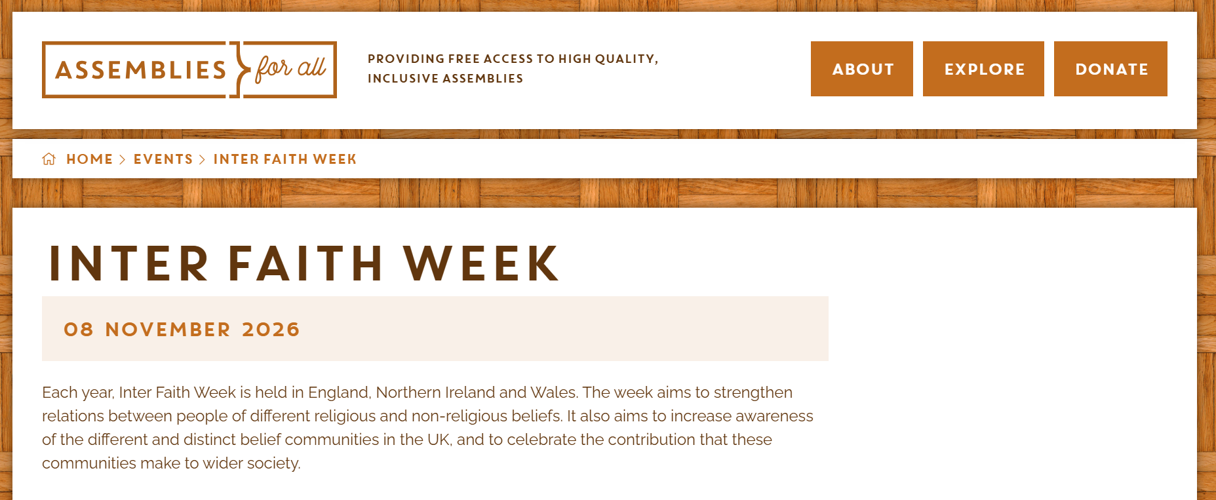
Source: https://assembliesforall.org.uk/events/inter-faith-week/

Slide 12
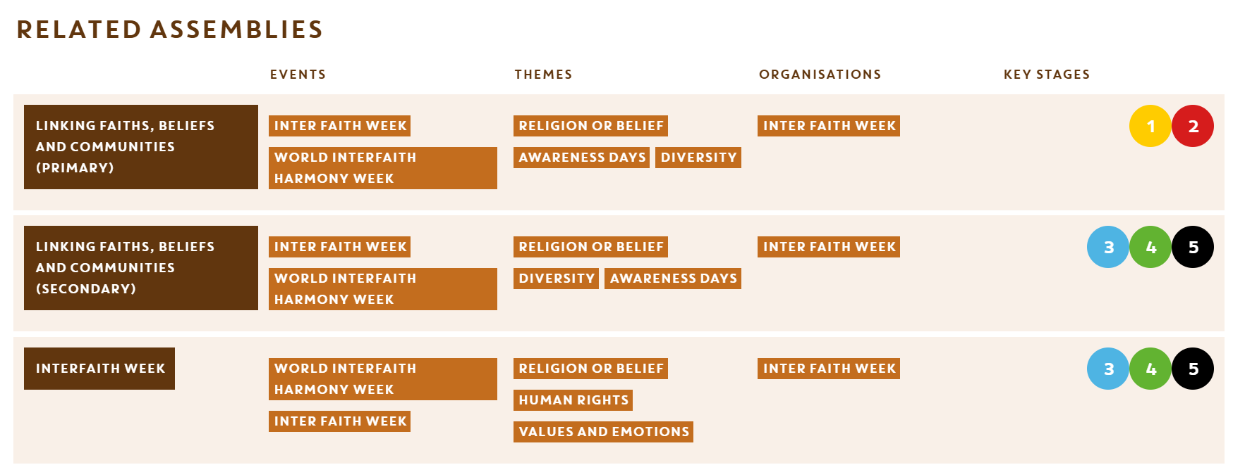
Click on the image above to take you to the website for further details on how to access these assemblies.
Source: https://assembliesforall.org.uk/events/inter-faith-week/

Slide 13
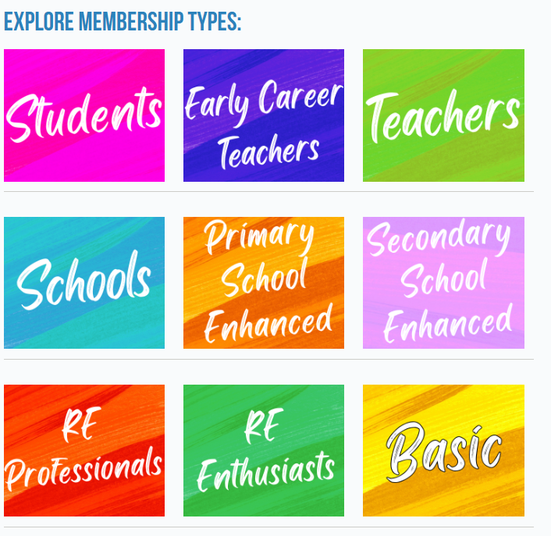
Get the help and resources You need to thrive in your teaching career with NATRE membership
We want you to start your teaching career with confidence, so your membership also includes the NEW2RE helpline to get support from RE experts.
With access to help and support for those tough teaching situations, we can give you the support and advice you need.
Start building up your own library of RE publications and teaching resources, which will equip you in the classroom, you have as you change schools and grow in experience and develop your expertise throughout your teaching career.
Member benefits
Termly REtoday magazine which focuses on classroom best practice and RE-related news
Free termly Primary OR Secondary curriculum book packed full of practical classroom activities
Monthly newsletter with a free teaching resource plus links to additional resources, news and relevant events
Free online access to REtoday articles in our online library
Free online access to Professional REflection articles in our online library
25% discount on all courses
25% discount on RE teaching books
A virtual welcome webinar at our very own Café NATRE to meet other new members
Discounted entry to our national conference Strictly RE
Access to the member area of the NATRE website with over 2,000 free resources
Free digital ‘RE in Action’ book
Access to advice from our RE Advisers
Access to Local Groups
Exclusive online access to the British Journal of Religious Education
Helpline to access advice on RE-related issues
Pay just
£58 for the year (£4.83 per month)
Join today
Email:admin@natre.org.uk
Call: 0121 458 3313
Join online
Terms and Conditions apply

